Slide 1
Attendance Management system

Slide 2
Problem identification

Slide 3
Aims and objectives
Aims
To develop web application for managing the attendance system
To control the attendance condition for the students and their staff
Objectives
To make the automated attendance management system
Help in managing and tracking and updating the data
To create less amount of proxy attendance
To provide the accurate time periods for the attended staffs

Slide 4
features

Slide 5
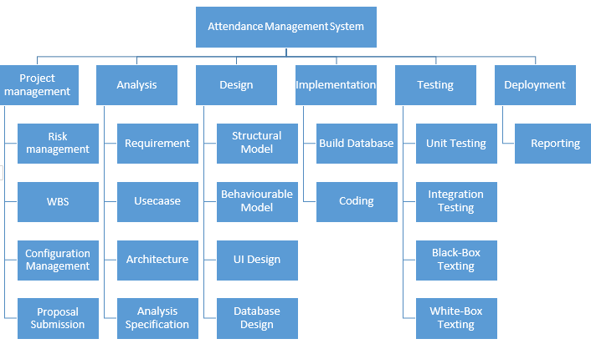
Work breakdown system

Slide 6
Gantt chart
For allocating resources to activities

Slide 7
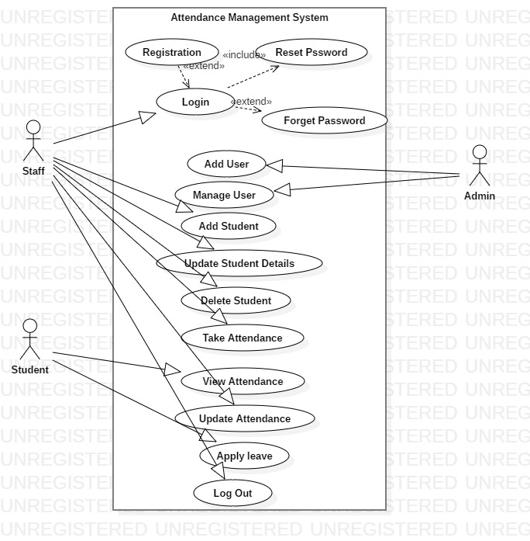
Use Case Diagram

Slide 8
Methodology

Slide 9
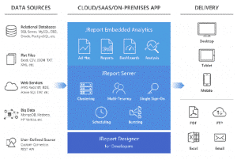
Architecture
3- Tier Architecture

Slide 10
3-tier Architecture
Presentation tier
Web development framework and communicates with other layers though Api calls
HTML5, JavaScript, CSS
Application tier
Application core capabilities
Java, .NET, C#, Python, C++
Data tier
Database/data storage system and data access layer
MySQL, Oracle, PostgreSQL, Microsoft SQL Server, MongoDB
Accessed by application layer via api

Slide 11
Risk management
Risk identification
Risk assessment
Risk containment

Slide 12
Risk identification
Project risks
Technical risks
Business risks

Slide 13
Risk assessment
Risks related in terms of their damage causing potential
Rated in 2 ways
Likelihood of risks coming true (r)
Consequence of problems associated with that risk (s)
Priority = r * s

Slide 14
Risk containment
Avoid the risk
Transfer the risk
Risk reduction
Risk leverage = (risk exposure before reduction
-
risk exposure after reduction)
/
cost of reduction

Slide 15
Software configuration management
Tracking & controlling the configuration of a software product
Elements
Configuration identification
Configuration control
Configuration auditing
Configuration status reporting

Slide 16
design

Slide 17
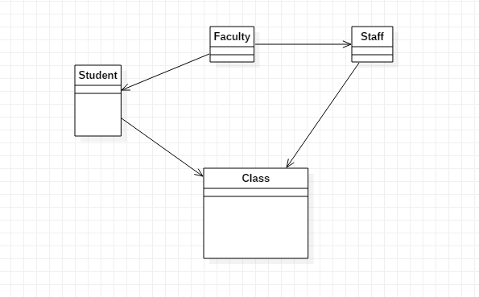
Class diagram

Slide 18
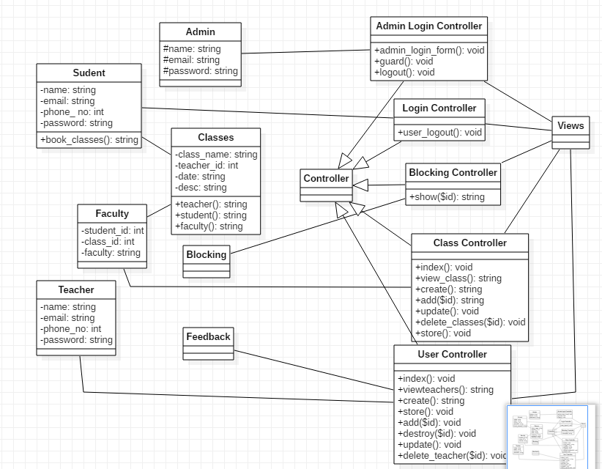
Final class Diagram

Slide 19
Use Case Diagram

